Slide 1
A PRACTICAL WAY TO INTRODUCE A WORLDWIDE JEWELLERY ETHICAL TRADE SYSTEM.
RAPAPORT FAIR TRADE JEWELRY CONFERENCE
Presented by: Damien Cody
ICA Ambassador Australia

Slide 2
Gaetano Cavalieri & Andrew Cody

Slide 3
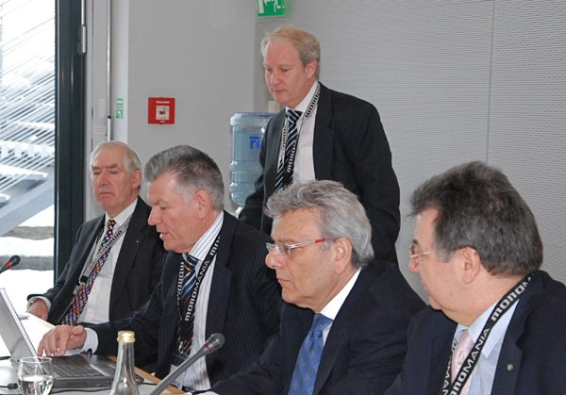
CIBJO Executive council with Prof. Donald Feaver & Dr. Kenneth Wilson

Slide 4
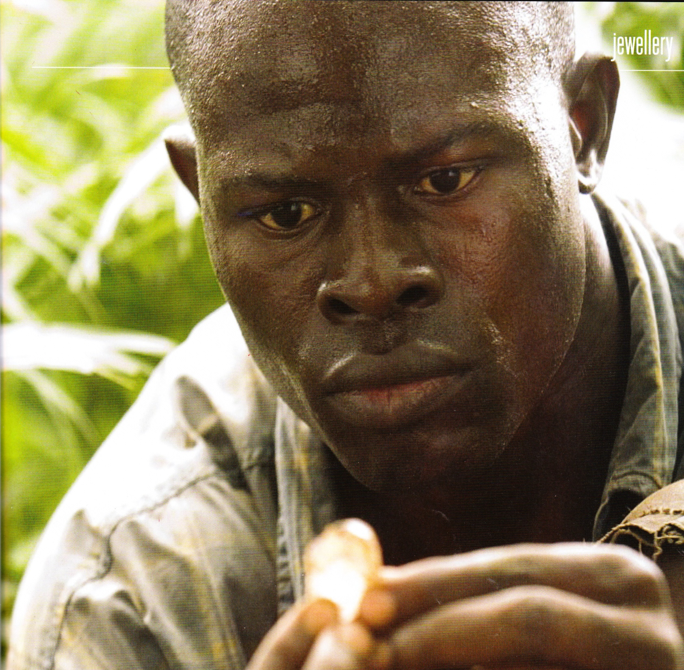

Slide 5
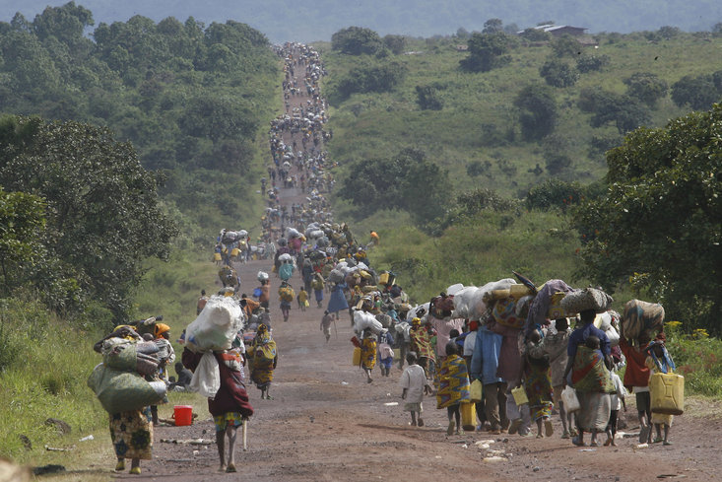

Slide 6
The World Bank

Slide 7
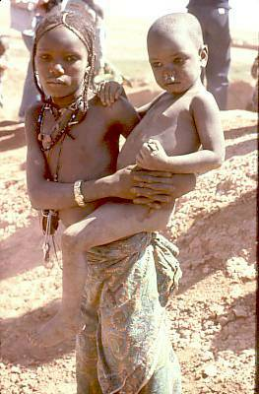
The people who suffer on the mines can’t afford to wait too long -let’s work together to try and bring in Ethical Trade a reality.

Slide 8
JEWELLERY SUPPLY CHAIN
?
What makes a mining operation Ethical?
Mining
Metals
Gold
Platinum
Gemstones
Diamond
Suppliers of Materials
Silver
Others
Colored
Organic
First Tier
Large Scale Miners-Small Scale Miners
Labor issues
Environmental issues
Who receives the returns
Treatments
Human Rights
Youth
Wages & Conditions
Safety considerations
Community Benefits
Community displacements
Disclosure
Safety issues-irradiation
Permanency of treatment
Environmental impact
Chemical pollution
Landscape scarring
Trees
Wildlife
Political?
Terrorists?
Smuggling
Money laundering

Slide 9
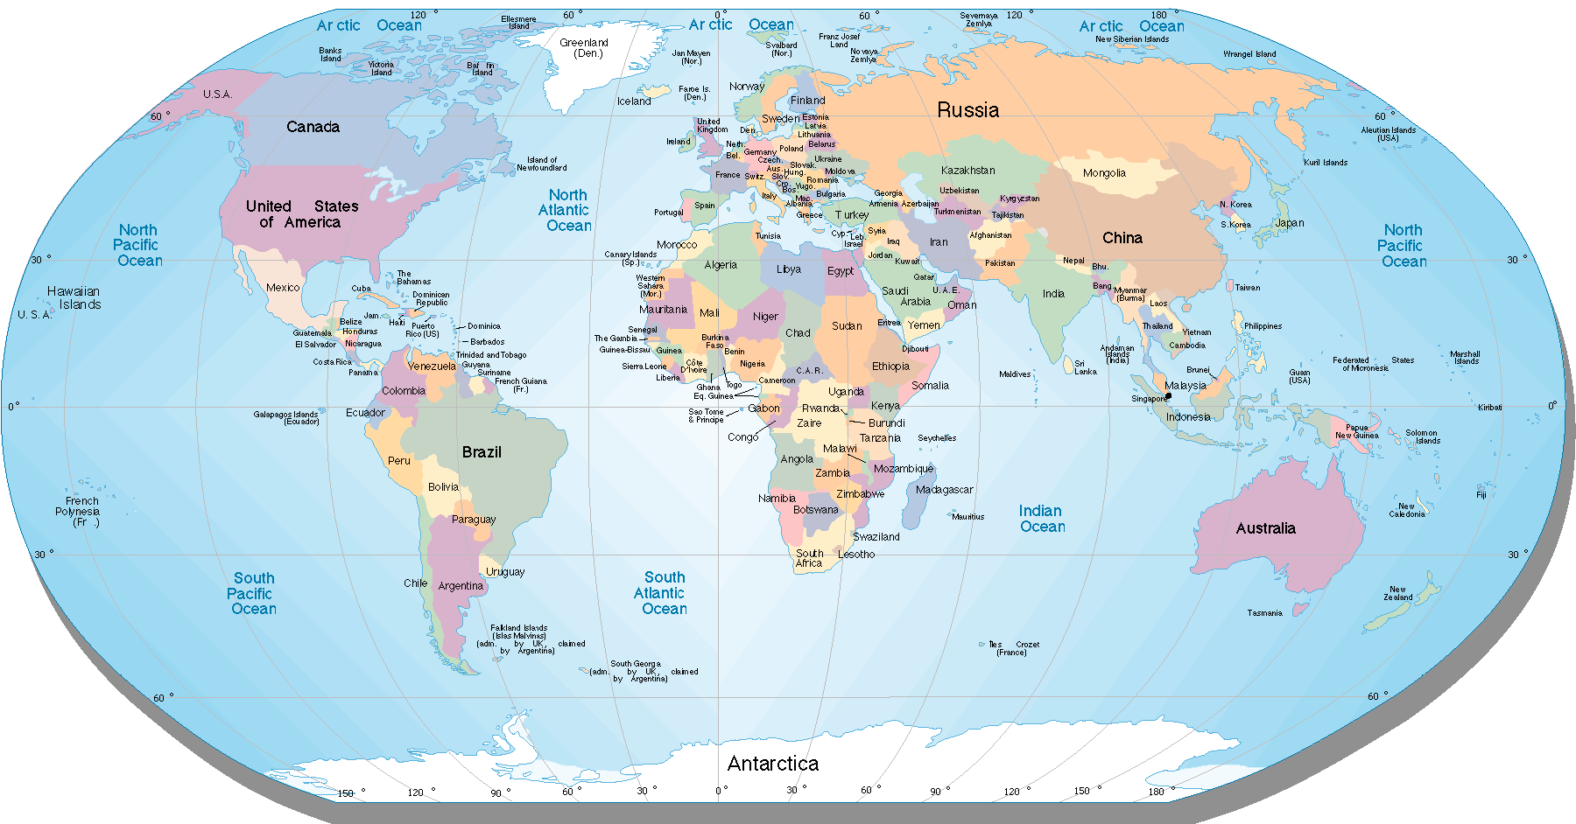
203 Sovereign States
Different Cultures
Different Standards
Different Rules

Slide 10
Ethical Trade Issues Facing First Tier - Mining
Labour issues
Environmental issues
Who receives the returns
Treatments
Human rights
Youth
Wages & Conditions
Safety conditions
Displacement of communities
Chemical pollution
Landscape scarring
Trees
Wildlife
Political
Terrorists
Money Laundering
Smuggling
Disclosure
Safety issues

Slide 11
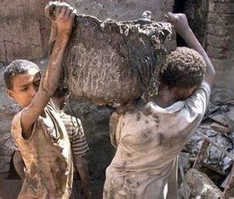
Human rights
Youth
Wages & Conditions
Safety conditions
Displacement of communities

Slide 12
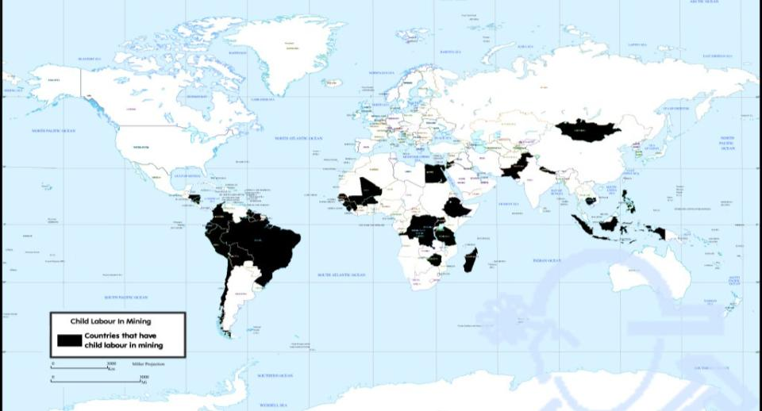
Child Labour in Mining
Human rights
Youth
Wages & Conditions
Safety conditions
Displacement of communities

Slide 13
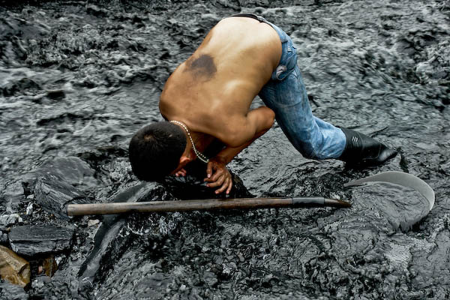
Human rights
Youth
Wages & Conditions
Safety conditions
Displacement of communities

Slide 14
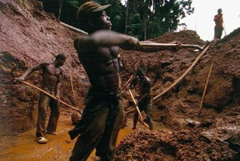
Human rights
Youth
Wages & Conditions
Safety conditions
Displacement of communities

Slide 15
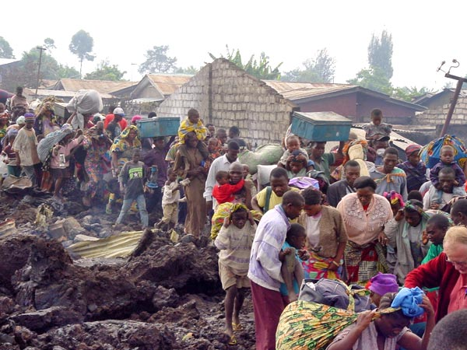
Human rights
Youth
Wages & Conditions
Safety conditions
Displacement of communities

Slide 16
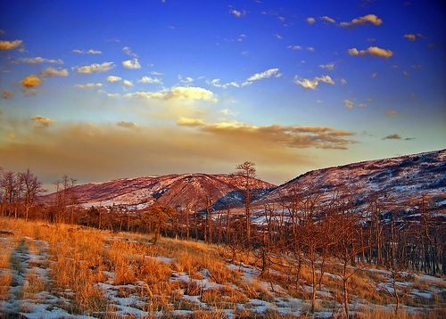
Chemical pollution
Landscape scarring
Trees
Wildlife

Slide 17
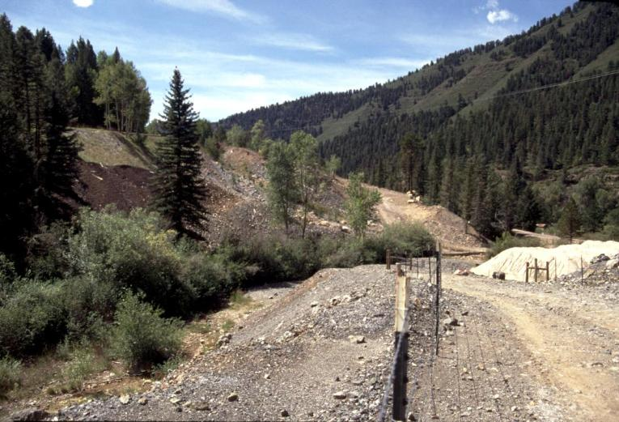
Environmental Impacts
Chemical pollution
Landscape scarring
Trees
Wildlife

Slide 18
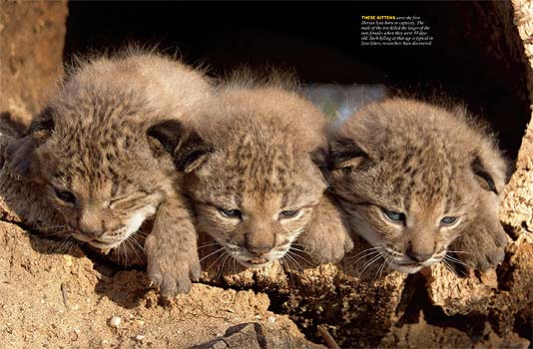
Chemical pollution
Landscape scarring
Trees
Wildlife

Slide 19
Political
Terrorists
Money Laundering
Smuggling

Slide 20
Political
Terrorists
Money Laundering
Smuggling

Slide 21
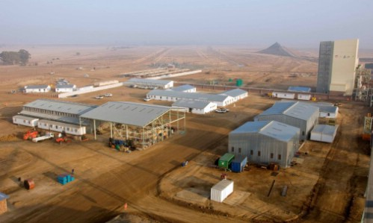
Large Miners will be easier to regulate

Slide 22
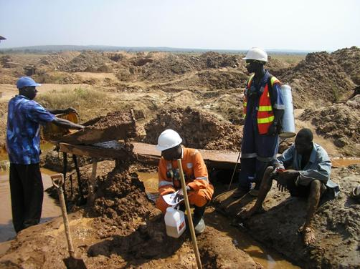
There are millions of artisanal miners.

Slide 23
The proposal works on the following principles:
To develop a global ethical trade system throughout the supply chain and embracing both large and small participants.
It is designed to be inclusive of other initiatives-providing a channel for their products to reach down the supply chain to wholesalers and retailers.
It is designed to utilise existing structures within the industry rather than creating new structures. EG CIBJO-World Jewellery Confederation, will administer the system to members of CIBJO, and the national and international organisations that are members of CIBJO will manage and operate the program to their membership.

Slide 24
The proposal works on the following principles:
It is designed to encourage broad participation and embrace further development of ethical trade as it evolves over time.
Initially the system will accredit retailers and wholesalers in major developed economies as these groups are already ethically aware and it will also capture the majority of jewellery sales.
The JETS program will be underpinned by creation of training modules which will be set up to accredit executives and staff.
The JET System will create important branding known as ‘World Jewellery Confederation Ethical Trader’, and will be co-branded with the name of the national/international CIBJO member that a participant belongs to.

Slide 25
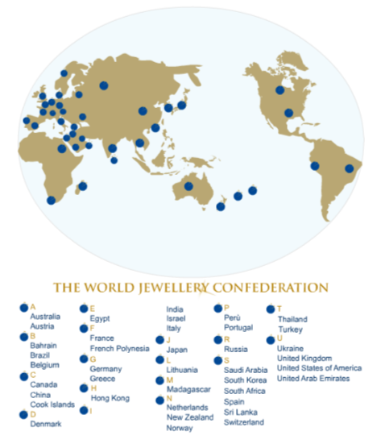

Slide 26
Advice input from NGO’s and Ethical Trade initiatives to advise on standards
UNDP
ARM
World Bank
CASM
No dirty gold
IRMA
DDI
End Poverty
JETS ADMINISTRATION
JETS operations & management
International & national associations with approved Code of Ethics (potentially 100 industry associations)
Wholesale and Retail members receive accreditation
Consumer Confidence

Slide 27
Ethical Trade Initiatives
No Dirty Gold
Ethical Metalsmiths
Kimberly Process
DDI
ARM
IRMA
CASM
CRJP
MINE _ _ _ _ _ _ _ _ _ _ _ _ _ _ _ _ _ _ _ _ _ _ _ _ _ _ _ _ _ _ _ _ _ _ _ _ _ _
PROCESSING _ _ _ _ _ _ _ _ _ _ _ _ _ _ _ _ _ _ _ _ _ _ _ _ _ _ _ _ _ _ _ _ _ _ _ _
WHOLESALE _ _ _ _ _ _ _ _ _ _ _ _ _ _ _ _ _ _ _ _ _ _ _ _ _ _ _ _ _ _ _ _ _ _ _ _
RETAIL _ _ _ _ _ _ _ _ _ _ _ _ _ _ _ _ _ _ _ _ _ _ _ _ _ _ _ _ _ _ _ _ _ _ _ _ _ _
Most initiatives do not have in place a solid connection or linkage with the retailer which would ensure a conduit for ethically certified product from mine to market.

Slide 28
Codes of Ethics contain rules by which members must abide.
JAA
Code of Ethics
Examples of Industry Codes of Ethics at work
International Colored Gemstone Association
Thai Gem & Jewellery Traders Assocation
Gemological Institute of America
Gemmological Association of Australia
Jewellers Association of Australia
Japan Jewellery Association
American Gem Trade Association
The Gemmological Association of Great Britain
British Jewellers Association
ETC
TGJTA
Code of Ethics
Colored Diamond Association
Code Of Ethics
AGTA
Code of Ethics
ICA
Code of Ethics
Japan Jewellers Association
Code of Ethics

Slide 29
The Jet System intends to create openings for certified products to the consumer.
It will recognise approved product certification of many other initiatives.
Examples...
Certified Ethical product
Certified Ethical product
Certified Ethical product
Certified Ethical Product
Recognised by CIBJO JETS program
World Jewellery Confederation
CRJP Retailer
Manufacturer
Jets Retailer
Ethically Aware Consumer

Slide 30
Don’t set the bar too high initially.

Slide 31
World Jewellery Confederation
ETHICAL TRADER
RETAILER 2009
International Colored Gemstone Association
World Jewellery Confederation
ETHICAL TRADER
MINER 2009
Canadian Jewellers Association
World Jewellery Confederation
ETHICAL TRADER
MANUFACTURER 2009
Jewellers Association of Australia

Slide 33
The next step involves the working team reporting back to CIBJO with a developed business plan which will include financial, legal and the proposed structure of the system. It will also include the training module especially developed for the system.
CIBJO has created a sub-committee of 6 executive board members to oversee the working party.
J E T S
Jewellery Ethical Trade System

