Slide 1

Moving beyond Kimberley:
The business case for ethical certification in the diamond industry
Colibrí Consulting
Certification for Sustainable Development
Michael E. Conroy, Ph.D.
______________________
Rapaport Diamonds Mtg.
New York City, 21 October 2010

Slide 2
Brief overview
Fundamental shifts in social values, and increasingly effective NGO activism
Key business dynamics of ethical certification
Success to date of major ethical certification systems relevant to natural resource extraction
Problems with existing mining assurance processes
Emerging ethical certification for diamonds

Slide 3





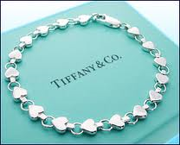
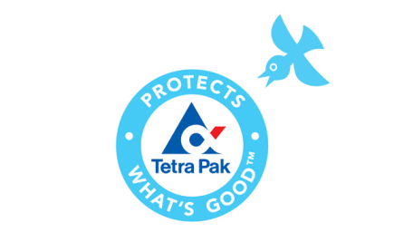







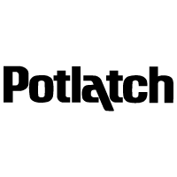




What do these companies have in common?
These global brands have all made major commitments to NGO-endorsed voluntary ethical certification systems as critical elements in their global growth strategies!

Slide 4

For American Consumers,
…a “Responsibility
Revolution”
September 10, 2009
“What we are discovering now, in the most uncertain economy since FDR's time, is that enlightened self-interest — call it a shared sense of responsibility — is good economics.”
“…People have been trading in their SUVs for Priuses, buying record amounts of fair-trade coffee and investing in socially responsible funds at higher rates than ever before.”

Slide 5
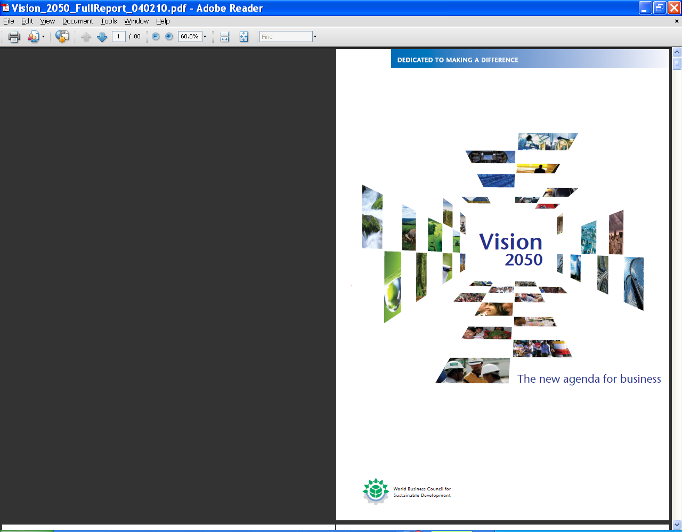
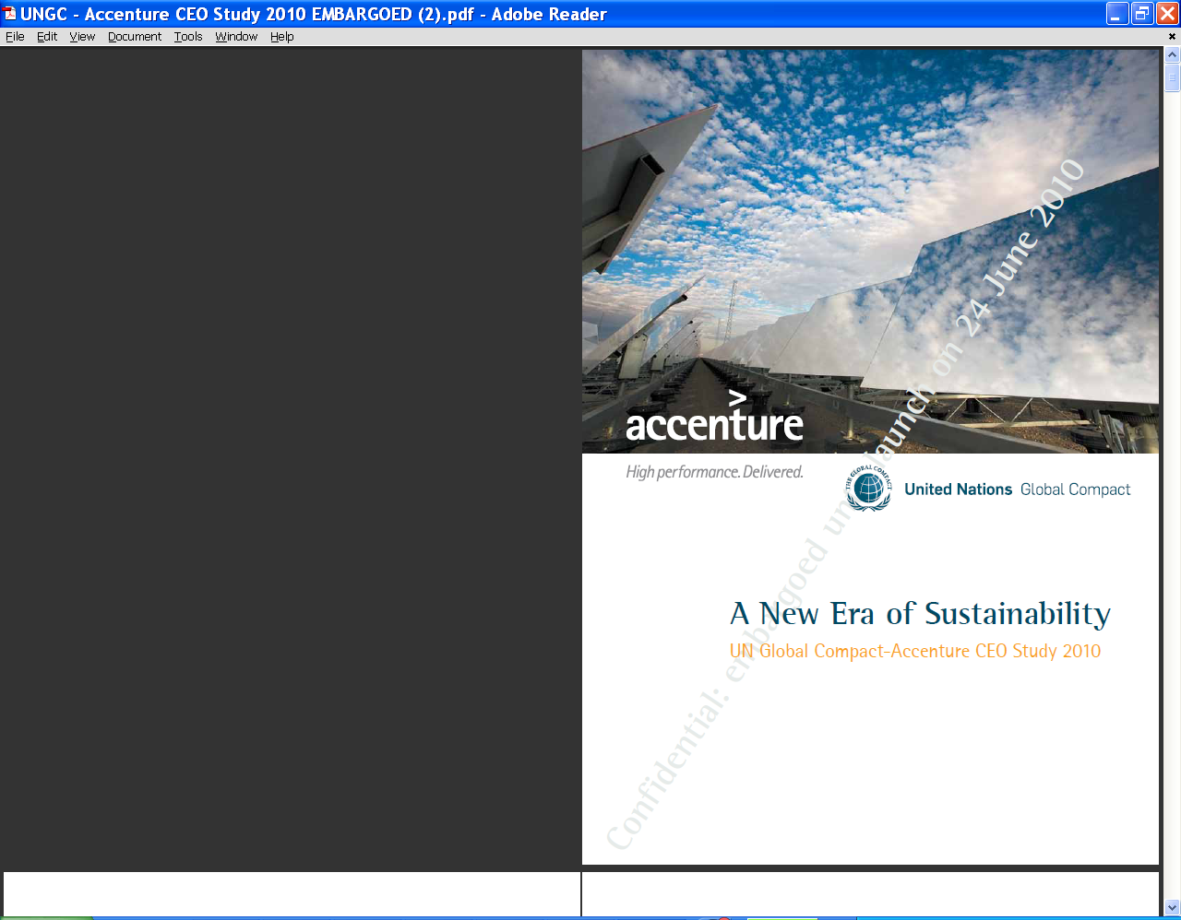
Corporate Responses to These Changing Social Values
  96% of CEOs see sustainability as a corporate imperative
  (up 24% in 2 years)
  88% will drive sustain-ability through supply chains
  Sustainability has both internal and external auditing dimensions
  NGOs are now seen as delivery partners.

Slide 6

A ‘certification revolution’?
Unparalleled changes in global corporate accountability on social and environmental practices over last 15 years
Intersection of three powerful forces:
    Brilliant “market campaigns” to drive corporate change
    Creation of third-party, independent “ethical certification systems” to verify compliance with stakeholder-based standards
    Internal champions within corporations who recognize the new corporate accountability imperative
Emergence of booming new markets for
“ethically-certified” products

Slide 7
What is a “market campaign”?
A coordinated campaign to call public attention to ethical problems in a company’s supply chain
Effectively directed at a company’s “brand” and capitalized value, more than at product markets
Driven in terms of the highest moral values
Effective only when undertaken with accurate and reliable information
Greatly facilitated by global internet and social network communications
Often leading to negotiations with the firm on the conditions under which the pressure is reduced

Slide 8
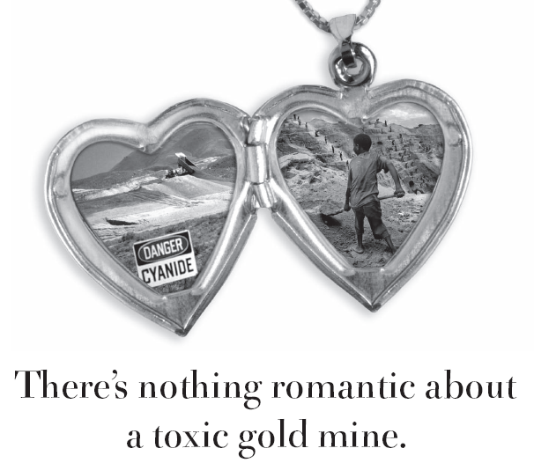
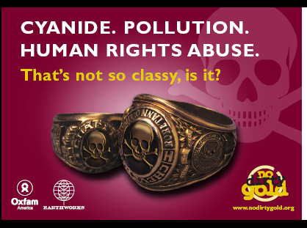

Slide 9
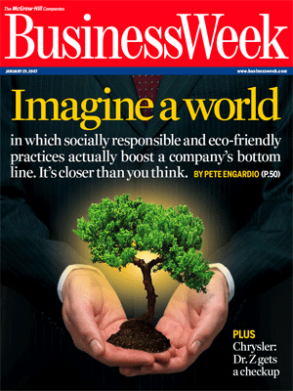
Supply chains as business drivers
This world is here now for forest products, fisheries, agricultural commodities and others!
Corporate accountability “right at the top of the agenda” for North American CEOs
“Growing clout of watchdog groups” recognized
“Brand value and shareholder value at risk…”
29 January 2007

Slide 10
The fundamental business dynamics…
“Branding” is the name of the globalization game!
BUT: Every dollar successfully invested in expanding brand recognition also increases risk of challenges to the brand on social and environmental grounds
Certification systems are just another form of risk mitigation in brand management
Certification systems reduce transaction costs for providing assurance of corporate social & environmental accountability
Only credible certification is 3rd party & independent, with explicit social and environmental NGO support

Slide 11
Ethical certification also brings…
Global co-branding with some of the best known NGOs in the world: including WWF, TNC, Greenpeace, Friends of the Earth, Earthworks, Oxfam International… and hundreds more globally
Defensive reputational benefits if other NGOs challenge certified company practices
Product differentiation in a brutal market from conventional/uncertified products
Supply-chain certification also brings other tangible financial benefits for marketing, finance (SRI), insurance, labor force turnover, and improved (more rapid?) social licensing
(Sometimes) price premia and (often) greater access to premium markets around the world

Slide 12
Who’s asking for ethical certification? B2B vs B2C
Most of the initial uptake in other systems has been driven by downstream B2B pressures, i.e., companies seeking assurance that their sourcing is free of specific social and environmental problems
Companies generate B2C pull as a basis for differentiating their products in the rapidly-growing markets for “ethically certified” products
Supportive NGOs contribute strongly to growing consumer awareness and acceptance
Market development time is getting shorter and shorter every year, with major benefits for first-entrants

Slide 13
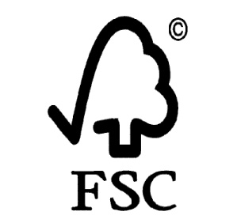
Impacts in ethical certification of natural resource products
FSC-certified forests now exceed 135 million hectares (335 million acres) worldwide, more than 14% of the world’s working forests, and coverage still growing at 15%/year
It is the only forest certification system with significant social protections for indigenous peoples, local communities, and workers
More than 40,000 FSC-certified products on the market; estimated retail sales > $40 billion

Slide 14
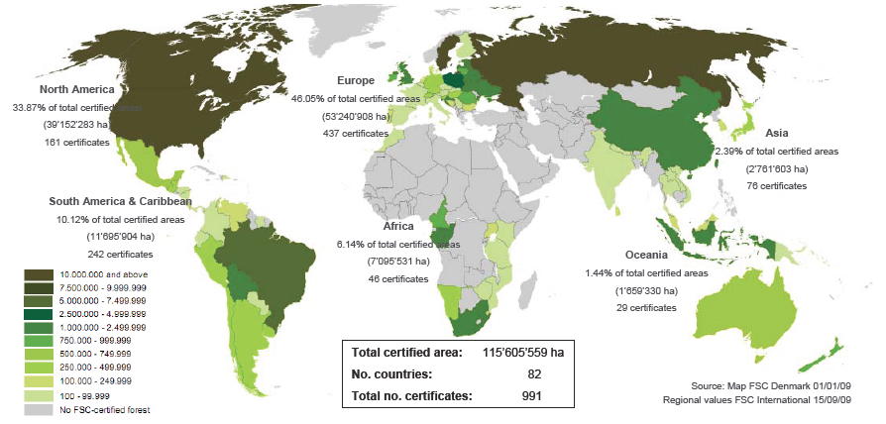
FSC global distribution (2009)

Slide 15
Evidence of booming demand for FSC certified final market materials

Slide 16
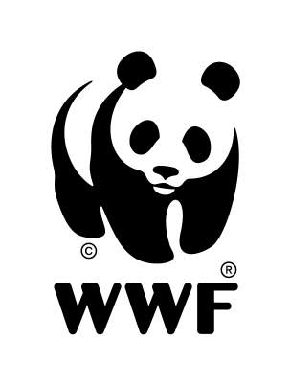





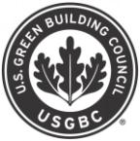


Strongly supported by leading NGOs
FSC is the only forest certifi-cation system recognized and supported by more than 140 leading global environmental
NGO’s
Notes:
- FSC was created by environmental organizations, and they continue to be strong boosters of FSC by promoting the purchase of FSC labeled products to their members
The endorsement by environmental orgs underpins FSC’s credibility with the public.
A component of our marketing plan involves providing tools and templates for these groups to market FSC to their members, key consumers of green products.

Slide 17







Evidence of demand for certification by consumer-facing companies
Largest manufacturer of tissue products in the world; K-C products found in 60% of American households
Committed in August 2009 to seek certification of 100% of wood fiber purchased, with strong public preference for FSC certification, and annual reports on compliance
By 2011 will have 40% of all fiber either recycled or FSC-certified

Slide 18
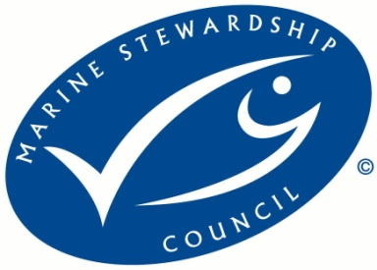
Another ethical certification for a natural resource industry
MSC-certified fisheries now cover 70% of ocean-caught salmon (not farmed!) and 26% of global whitefish harvests; MSC faces more requests for fishery certification than it can handle, because…
Walmart, the largest buyer and retail vendor of ocean-caught fish in the world, committed in October 2005 to source all of its ocean-caught fish solely from Marine Stewardship Council certified fisheries by 2011

Slide 19
Signs of success in other sectors?
Fair Trade Certified™ in 2010 will top US$6.0 billion in global retail sales, providing wide benefits to more than 1.4 million farm families; global retail sales growing at > 15% per year
Ethical certification of coffee production alone is expected to reach 25% of the total world production by 2015
Dual-certified Fair Trade and ARM gold, from artisanal mines, will reach markets this Fall

Slide 20



Largest vendor of chocolate products in European markets
Committed in February 2009 to convert sourcing of all cacao in its largest selling product in the UK, Cadbury Dairy Milk bars, to Fair Trade Certified™ by 2010, extending that commitment to all of Europe, South Africa, and Australia by 2012
Saved by FT certification in 2010 from BBC charges of child slavery on farms in Ghana where it sourced

Slide 21
Critical success factors for ethical certification systems to date…
Active, balanced, and well-informed stakeholder participation in standard setting and governance of the system (no one can impose standards; they must be negotiated)
Third-party independent auditing and verification with transparency and a dispute-response system:
Credibility thru some form of traceability to final products
Reasonable stability over time, not constantly changing
Distinguishable seal or logo with strong NGO support

Slide 22
What about existing mining assurance systems? Are they enough?
Many mining companies do internal auditing as part of their own management processes and already pay for external assurance
Common external assurance processes include:
  Kimberley Process
  ICMM Sustainability Process
  Global Reporting Initiative
  ISO standards series (9000, 14000, etc)
  Responsible Jewellery Council

Slide 23
Kimberley Process
Provides assurance ONLY about supposed “conflict-free origin” of diamonds by requiring the exporting governments “certify” that they have not come from a “conflict zone”
Contains NO social or environmental requirements
Contains NO assurance about human rights conditions
Clumsy, slow intergovernmental process, with most decisions linked to international political considerations (e.g., Zimbabwe)
Increasing evidence that it is easily evaded
No consumer-facing label, weak traceability on products

Slide 24
ICMM Sustainability Principles
10 principles, based on “lite” versions of GRI, and World Bank and IFC Performance Standards
Essentially first-party certification: company declares that it is compliant with them
Not specified at levels where actual verification is possible, no third-party independent verification, very little transparency
Little NGO involvement in their definition; and essentially no civil society trust that they can be linked to real performance; no recourse if company does not appear to be compliant

Slide 25
GRI: Global Reporting Initiative
Global Reporting Initiative contains guidelines for company-wide self-reporting on issues of sustainability; levels of compliance from C to A+; NGO-created, and significantly improved in 2006
New Mining and Minerals Supplement required in 2011 for top level (A or A+) compliance; only A+ level has external verification that reporting was done properly
GRI reporting does NOT set standards for actual social or environmental performance, not in terms of actual performance on the ground; so it offers little supply chain reputational risk reduction
GRI reporting does not have a consumer-facing product logo and it cannot be linked to specific products or specific sites

Slide 26
Various ISO certifications
Good for the development of “management systems” such as quality management, health and safety systems, or environmental management
(no social system yet)
Provide NO measurement (or certification) of actual performance with respect to those systems, ISO certification assures only that systems are in place
And so, even when verified, they give NO credibility to civil society about the actual performance of the company, of a product, or of a production site

Slide 27
RJC: Responsible Jewellery Council
Began to accept 3rd-party certification of member companies under its Code of Practices in early 2010
Very little NGO engagement in development of the standards; virtually no NGO support
Recent release of Chain-of-Custody process for diamonds, gold, and platinum; implementation not expected until 2012;
No site-specific traceability; so no possibility of verification of compliance with standards linked to product
No consumer-facing ethical label

Slide 28
Other ethical projects underway /1
DDI: Diamond Development Initiative
  Spinoff from Kimberley Process: envisions “envision ‘development diamonds,’ as diamonds that are produced responsibly, safely, with respect of human and communities’ rights, in conflict-free zones, with beneficiation to communities and payment of fair prices to miners. Under multistakeholder consultation.
Rapaport Fair Trade Diamonds
  “All diamonds that are legal and not directly involved in severe human rights violations should be freely, fairly and legally traded.” Awaiting creation of certification system.

Slide 29
Other ethical projects underway /2
Fair Trade USA diamonds certification project
  Initiated in 2009 with Tiffany & Co. Foundation support
  Created full feasibility study for potential certification at sites of diamond mining
  Created partial feasibility study for traceability through the very complex diamond supply chain
  Presently on hold, awaiting further funding for stages of standards development & indications of industry interest

Slide 30
And one more…
IRMA: The Initiative for Responsible Mining Assurance (www.responsiblemining.net)
  Development of standards, verification process, and governance model underway
  Active participation of major mining & jewelry retail companies, along with representatives of major NGOs, labor, and impacted communities
  Covers human rights, environmental impacts, indigenous peoples, world heritage sites, etc.
  Should be completed in 2011, launched in 2012

Slide 31
Summary
There are significant reputational risks in the diamonds supply chain that are not met by any of the current assurance systems, including Kimberley.
There are significant potential financial benefits for the industry in developing a consumer-facing ethical certification system.
What is needed is for the industry to recognize the need and to invest the (relatively) very modest funding needed for moving forward.

Slide 32
For more information on all these topics…
        Consider the book……..
        20-plus profiles of business
        and NGO leaders
        Chronicles of the classic
        battles between them
        Analyses of the evolving
        future potential of the
        “certification revolution.”
        All net royalties go to
        certification NGOs
michael@colibriconsult.net

