Slide 1
COLORED GEMSTONES From mine to market ETHICAL TRADE and MINING Certification CHALLENGES
Rapaport Fair Trade Jewelry Conference
Basel, CH- March 18th 2010
Jean Claude Michelou
Vice President ICA

Slide 2
Market Value factors
Fashion
Value
Cultural traditions

Slide 3
FAIR TRADE DEFINITION
Fair Trade seeks to address the underlying causes of poverty through new forms of trading relationships rather than merely tackling the symptoms by checking compliance with standards within individual operators and supply chains (Fair Trade Labeling Organization - FLO )

Slide 4
Currently accepted definition of Fair Trade
Fair Trade is a trading partnership, based on dialogue, transparency and respect, that seeks greater equity in international trade.
It contributes to sustainable development by offering better trading conditions to, and securing the rights of, marginalized producers and workers – especially in the South.
Fair Trade Organizations, backed by consumers, are engaged actively in supporting producers, awareness raising and in campaigning for changes in the rules and practice of conventional international trade.”
Fair Trade products are produced and traded in accordance with these principles – wherever possible verified by credible, independent assurance systems.

Slide 5
Fair Trade Principles
Market access for marginalised producers
Sustainable and equitable trading relationships
Capacity building & empowerment
Consumer awareness raising & advocacy.
Ensuring decent Working conditions
Gender Equity
Elimination of Child Labour
Environmental sustainability
Transparency and accountability
Monitoring and Evaluation

Slide 6
CONSUMERS
Final Value
RETAILERS
INTERNET
JEWELLERY TV
Jewellery
And
Manufacturing
MANUFACTURERS and DESIGNERS
GEMSTONE PROCESSORS and WHOLESALERS GEMDEALERS
Extraction and processing
(including gold and diamond)
MINERS
ASM, Medium Scale and Large Scale Mining

Slide 7
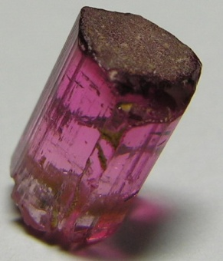
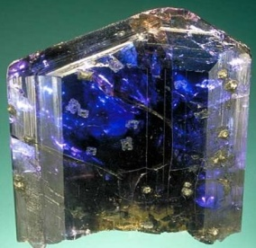
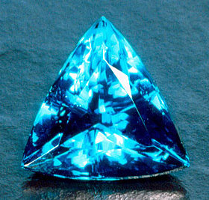
Value
Rarity
Clarity
Ethics

Slide 8
What sustains the value?
UNLIKE GOLD , NOT A COMMODITY
UNLIKE DIAMONDS NO CENTRALIZED MARKETING AND MARKET PRICE CONTROL
VALUE BASED ON REGIONAL AND SEASONAL MARKETING AND BRANDING STRATEGIES
SOCIAL CATEGORY IMPACT
INVESTMENT ONLY FOR TOP EXCEPTIONAL PIECES

Slide 9
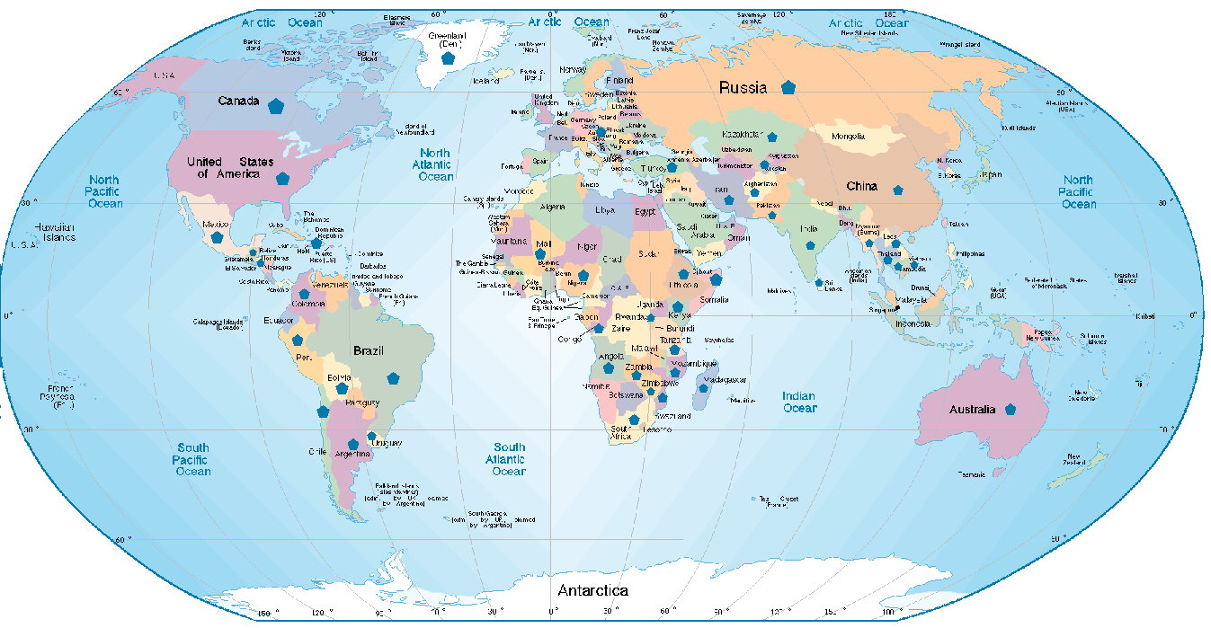
47 MAIN GEMSTONE SUPPLIER COUNTRIES
AFRICA ASIA AMERICAS EUROPA OCEANIA
East Africa Ethiopia
Somalia Madagascar Kenya
Uganda
Tanzania Mozambique Zambia
Zimbabwe
Malawi
Rwanda
Central Africa
Congo
Angola
West Africa
Nigeria
Mali
South Africa
Namibia
South Africa
Central Asia Afghanistan Tajikistan Kazakhstan
Pakistan
Eastern Asia China
India
Sri Lanka
Burma
Vietnam Thailand Cambodia
Laos
Middle East
Iran
Turquey
North America
USA
Canada
Greenland
Mexico
Central America
Dominican Rep.
Guatemala
Honduras
South America
Colombia Uruguay
Peru Chile
Bolivia Argentina
Brazil
Czech Rep. Russia
Australia

Slide 10
FACTS
80 % of Colored Stone Supply comes from Artisanal Small Scale Mining (ASM)
90 % of ASM is located in Developing and Emerging countries
Development expectations limitations:
Lack of investment capacity
Lack of professional capacity or mining techniques
Low potential of deposit yield
Extreme nature conditions and limited accessibility

Slide 11
ASM ISSUES
Labor issues
Capacity Building and training issues
Environmental issues
Who receives the returns
Treatment

Slide 12
OPEN PIT EMERALD MINING High level damage to the environment

Slide 13
SPESSARTITE ASM Dangerous work conditions
TOURMALINE ASM
Damage to the environment

Slide 14
PRINCIPLE OF CERTIFICATION FOR ETHICAL MINING
Based on certification of country of origin
Establishment of 3 simple criteria
Development of value chain
Formal and certified exports
Sustainable poverty reduction and social responsibilities initiatives

Slide 15
FAIR TRADE AND THE GEMTONE SUPPLY CHAIN
ASM AND MEDIUM SCALE MINING
ROUGH SUPPLY TO PROCESSING MARKETS
CAPACITY BUILDING IN :
MINING TECHNIQUES
STONE PROCESSING - LAPIDARY
GEMOLOGY AND GEM MINERAL IDENTIFICATION
RESEARCH AND CERTIFICATION
ETHICAL MINING AND CSR INITIATIVES
CERTIFIED AND TRANSPARENT EXPORT PROCEDURES
FULL DISCLOSURE OF TREATMENTS AND ORIGINS

Slide 16
MAIN ISSUES TO BE ADDRESSED AT MINE SITES
1 EDUCATION IN MINE CAMPS OR SURROUNDING SUB MINING
COMMUNITIES
2. HEALTH AND FIRST AID CARE
3. SANITATION AT MINING LOCATIONS AND CAMPS
4. WATER ,LIGHT AND COMMUNICATION ISSUES IN MINE CAMPS
5. MINE PITS AND TUNNELS MINING CONDITIONS
6. LAND COMMUNICATIONS
7. WOMEN PROTECTION- EDUCATION AND SUBSTANTIVE ACTIVITIES
8. ENVIRONMENT IMPROVEMENT AND PROTECTION

Slide 17
The World Bank

Slide 18
ETHICAL GEMSTONE AND ORIGIN CERTIFICATE
C OUNTRY OF ISSUANCE
Certifies hereby that the Gemstones consigned within the export document No---------- have been inspected and are compliant with the Ethical Mining and Trading National commitments

Slide 19
ETHICAL MNING AND TRADE
C O U N T R Y C E R T I F I C A T E
National Trade Orgs
J E T S, RJC
or Equivalent
Independent organizations

Slide 20
GEMSTONE COUNTRY CERTIFICATE
No…
Ethical Trade Central Organization
ETHICAL
MINER 2010
GEMSTONE PROCESSORS/ CUTTERS
CERTIFICATE
Ethical Trade Central Organization
ETHICAL
TRADER 2010
Ethical Trade Central Organization
JEWELRY MANUFACTURERS
ETHICAL MANUFACTURER 2010
RETAILERS
Ethical Trade Central Organization
ETHICAL
RETAILER 2010
CONSUMERS

Slide 21
ETHICAL TRADE AND CSR LINKAGES WITH PRODUCING COUNTRIES
MODEL OF CERTIFICATION OF ORIGIN
DEVELOPMENT IN NIGERIA OF A CASE MODEL OF ETHICAL TRADE AND MINING AND EXPORT CERTIFICATION . SMMRP / WORLD BANK PROJECT
DEVELOPMENT IN NIGERIA OF CASE MODELS OF CSR WITH PRIVATE NATIONAL AND INTERNATIONAL SECTOR IN PARTNERSHIP WITH NIGERIAN GOVERNMENT
IMPLEMENTATION IN NIGERIA OF PROJECT LINKING ASM , POVERTY REDUCTION, CAPACITY BUILDING , TRANSPARENT AND FORMAL BUYING AND EXPORT PLATFORM . SMMRP/ WORLD BANK PROJECT

